Slide 1
CS5351 Software Engineering 2025/2026 Semester A Software Testing
Dr W.K. Chan
Department of Computer Science
Email: wkchan@cityu.edu.hk
Website: http://www.cs.cityu.edu.hk/~wkchan

Slide 2
Outline
What is a Testing Process?
General Process Step
Continuous Integration
Fuzzing
Scientific Debugging
Delta Debugging

Slide 3
What is Program Testing?
Conduct validation on a program to find bugs or demonstrate the program working under certain scenarios (acceptance test).

Slide 4
Procedure for Program Testing
The specific “Goal”
Test Automation Possible
Step 1
Defining Test
Objectives
Step 2
Test Design
Step 3
Test Execution
Step 4
Test Analysis
How.
We use JUnit,
UI capture and replay tool
Measure how well the “How” achieves the “What”
What: Define the test requirements.
e.g., test every exception handler in the user requirements
Developers should not just play around a while and judge whether the system passes the test.

Slide 5
Procedure for Program Testing (1)
Defining Test
Objectives
Test Design
Test Execution
Test Analysis
Define the overall goal for designing and executing a test and the type of tests to be conducted.
E.g.:
To get, clarify, and concretize user requirements by examples
To demo the production code meeting user requirements
To guard against previously found bugs (regression testing).
User acceptance test, system acceptance test, security test
To test the integration of two subsystems

Slide 6
Procedure for Program Testing (2)
Defining Test
Objectives
Test Design
Test Execution
Test Analysis
Goal: e.g., To get, clarify, and concretize user requirements by examples
Implement test code (or define test profiles for fuzzing)
e.g., Write a test class (e.g., in JUnit) to exemplify I/O for user requirements.

Slide 7
Procedure for Program Testing (3)
Defining Test
Objectives
Test Design
Test Execution
Test Analysis
Execute the test cases written in the Test Design step.
E.g.,
Run the JUnit test scripts
Run in Continuous Integration
Notes:
http://msdn.microsoft.com/en-us/library/ms182613%28VS.80%29.aspx

Slide 8
Procedure for Software Testing (4)
Defining Test
Objectives
Test Design
Test Execution
Test Analysis
Identify failures and anomalies from the test results
If we want to automate Step 2 or Step 3, we shall automate this step as well.
Examples:
Using Assertion statements in the JUnit test script. assertEqual(Account.credit(Money) – Account.balance(), 0)
Crash an Android app by running Android Monkey.
We may manually observe and judge the test results, but non-productively.

Slide 9
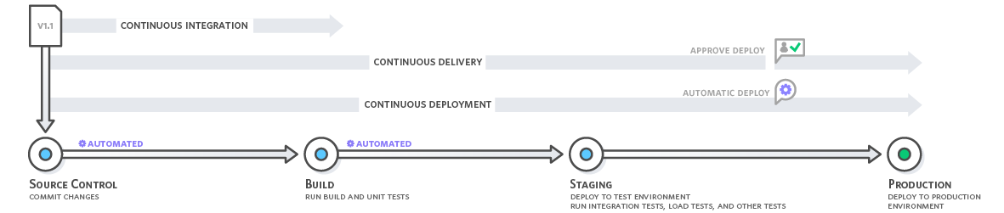
Automation or Not?
This process is enhanced by AI now!
e.g., Gitlab: https://youtu.be/sTpSLwX5DIs
Traditional scenario:
while (i) do
{develop in Month-i; deploy in Month-(i+1);}
Nowadays scenarios (continuous delivery):
while (i) do
{develop in Day-i;
locally test in Day-i; commit in Day-i;
build in Day-i; deploy in Day-i; i++;}
Image source: amazon.com

Slide 10
Continuous Integration (CI)
Use a single shared repository (CI server) to host and integrate the main branch of code (baseline) frequently
Developers’ practices
Before pulling into the CI server, conduct the unit test locally
Make commits every day (to synchronize the common baseline)
Enhance the test scripts to validate every bug-fixing commit
Every commit in the CI server triggers an automated build in an integration environment
We need a build script and unit test scripts
The build should include self-testing (run tests by itself)
Test in a clone of the production environment (known as staging) after validating the committed code at the unit test level
Continuous Delivery (CD) extends CI with auto-deployment

Slide 11
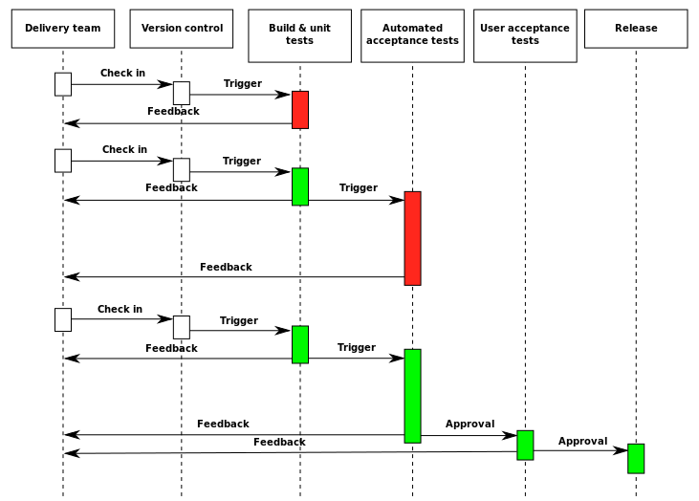
In a Larger Context
Continuous delivery/deployment (CD) [18]
Is a process to deploy software into production iteratively.
Key characteristics:
Software is updated in small increments that are independently deployable
Fully auto-deploy them immediately after development and testing are completed
The decision to deploy is largely left up to the developers
Developers responsible for development, deployment, and testing can be notified immediately when system failure in production occurs.
Key practice (read Section 2 of Ref [18])
Implement automated unit- and sub-system tests
Must use automated testing tools to enable early and frequent testing
Incorporate code review
Configure auto-deployment tool
Deploy the updates by stage.

Slide 12
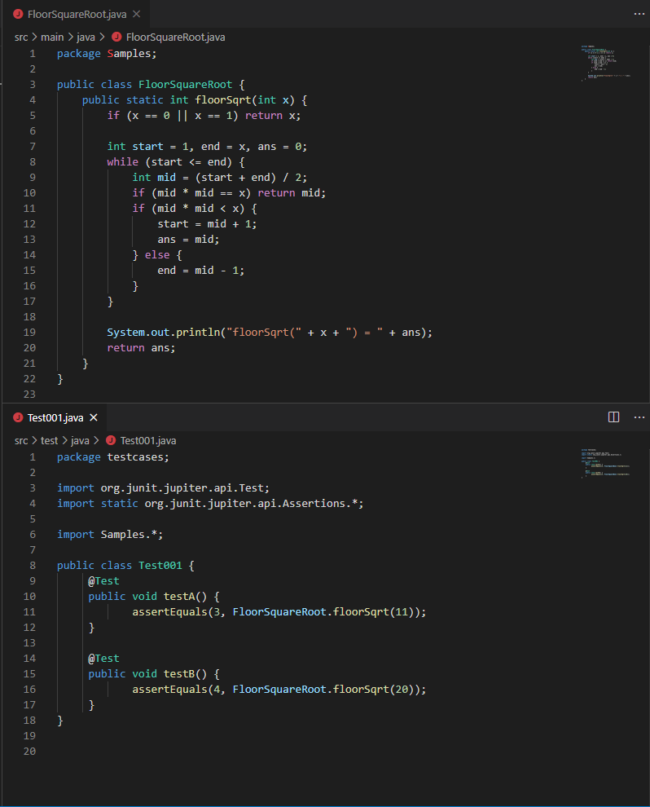
In-Class Demo on CI
Your Code and Test Code
Your code for integration should accomplish with your test code
We have “Continuous Integration with GitHub Project” on the Canvas website when working on this demo.
Notes:
---------FloorSquareRoot.java ------------
package Samples; public class FloorSquareRoot { public static int floorSqrt(int x) { if (x == 0 || x == 1) return x; int start = 1, end = x, ans = 0; while (start <= end) { int mid = (start + end) / 2; if (mid * mid == x) return mid; if (mid * mid < x) { start = mid + 1; ans = mid; } else { end = mid - 1; } } System.out.println("floorSqrt(" + x + ") = " + ans); return ans; }}
---------Test001.java------------
package testcases; import org.junit.jupiter.api.Test;import static org.junit.jupiter.api.Assertions.*; import Samples.*; public class Test001 { @Test public void testA() { assertEquals(3, FloorSquareRoot.floorSqrt(11)); } @Test public void testB() { assertEquals(4, FloorSquareRoot.floorSqrt(20)); }}

Slide 13
Making Software Testable
Sometimes, our code module needs to call other code modules, but we want to test our code module without any interaction with others.
Example: In the source code, we may have the following code structure. Suppose that we are testing the integration of A and B, but without the code of C is not ready.
...
int a(ClassB b){
...
b.b2( );
}
...
Class ClassB {
private ClassC c;
public ClassB(ClassC c1)
{ c = c1;}
public void b2( ){
c.c1(); c.c2();
c.c3(); c.c4();
};
}
In a test script, we set up an object b1 to use an object of class Cstub instead of the original class C.
stubForC = new Cstub();
b1 = new B(stubForC);
...
a(b1);
Create this subclass
for testing
purpose
C
Cstub
To use this style of testing, your class B needs a careful design.

Slide 14
Making Software Testable
C
Cstub
Class A { ...
void a(ClassB b){
...
b.b2( );
}}
...
Class ClassB {
private ClassC c;
public void b2( ){
c.c1(); c.c2();
c.c3(); c.c4();
}
public void ClassB(ClassC seed){
c = seed;
}
}
Class A { ...
void a(){
ClassC seed = new ClassC();
ClassB b = new ClassB(seed);
b.b2( );
}}
...
Class ClassB {
private ClassC c;
public void b2( ){
c.c1(); c.c2();
c.c3(); c.c4();
}
public ClassB(ClassC seed){
c = seed;
}
}
Test script can set the state of b. Hence, C can be remained untested before testing A and B. So, top-down testing is feasible.
Class A controls the state of B. Class C must be tested before testing A and B. So, only bottom-up testing is feasible.
Can be tested in a standalone manner
less testable
For some classes, we do top-down testing; for the other classes, we do bottom-up testing. We need a sandwich approach.

Slide 15
Some Characteristics of Effective Testing in Uncertain User Needs [3]
In Agile development, requirements are often not defined in detail, and without strict processes to elicit them, developers need an understanding of the business and experience in the domain model.
Requirement testing (via system testing): demonstrate the (vague and incomplete) requirement rather than finding bugs in the design and implementation.
Test coverage: knowing all possible usage scenarios is infeasible. Paying more attention to test features with larger user bases in the next release of the program. Judge by developers on whether the feature has been sufficiently tested for the users to make effective use of the feature.
Test automation: DO NOT replace manual testing. However, it is a good way to show users that the produced code is testable to educate users to raise checkable requirements and support feature implementation approval in a testable way.

Slide 16
Testing in Uncertain User Needs

Slide 17
Pair Programming
Pair programming is a practice used in agile development
Developers X and Y write the same piece of code simultaneously.
≠ X writes the code, and Y reviews the code after code completion
≠ X independently completes part A, and Y independently completes part B, and then the two parts are integrated
= Y reviews the code being written while X writes each line; X and Y may switch their roles during the process

Slide 18
Testing in Uncertain User Needs: In-Class Exercise on “Lab1”
Study the Java code project on the next slide. The code project contains at least one bug, and the exact requirement is unclear to you.
See the cheat sheet for Hello World in Java in the appendix if you do not know Java.
Form a team of two students (i.e., for pair programming)
Use your judgment to “guess” what the code project aims to do. Add more JUnit test cases to represent the requirements you guessed. Get a consensus between the two while writing the same line of code
Brainstorm low-probability usage scenarios that the code project can use. Create JUnit test cases to represent these usage scenarios.
Still recall the brainstorming session method in requirement elicitation?
Timeline (in minutes)
00-03: Study the code. Use the shared Word document for your team. [see discussion board]
04-20: Complete Task 1. Write in the shared Word document.
20-30: Complete Task 2.

Slide 19
Testing in Uncertain User Needs: In-Class Exercise on “Lab1”
package Lab1;
public class UR {
int sizeOfCake;
UR(int size) {
this.sizeOfCake = size;
}
boolean dividingCake(int pieces) {
int size = this.sizeOfCake / pieces;
System.out.println("the size of each piece of cake: " + size);
return true;
}
}
package Lab1.testcase;
import static org.junit.jupiter.api.Assertions.*;
import org.junit.jupiter.api.Test;
public class TestUR {
@Test
public void test() {
UR r = new UR(6);
r.dividingCake(6);
r.dividingCake(3);
}
}
Fix the bugs if your test case exposed it.

Slide 20
Testing in Uncertain User Needs: In-Class Exercise on “Lab1” (Solution)
Actual User Requirement: The goal of the method dividingCake() is to divide a cake into several pieces of equal size. The method is designed to return a Boolean value. Specifically, if the size of a piece of cake is less than 2, the method should return false, otherwise true. A message about the size of each piece should be displayed.
package Lab1;
public class UR {
int sizeOfCake;
UR(int size) {
this.sizeOfCake = size;
}
boolean dividingCake(int pieces) { // return a Boolean value
float size = this.sizeOfCake / (1.0*pieces);
System.out.println("the size of each piece of cake: " + size);
if (size < 2) return false; // omission fault
return true;
}
}
package Lab1.testcase;
import static org.junit.jupiter.api.Assertions.*;
import org.junit.jupiter.api.Test;
public class TestUR {
@Test
public void test() {
boolean s;
UR r1 = new UR(6);
r1.dividingCake(6);
r1.dividingCake(3);
r1.dividingCake(4); // bug found
r1.dividingCake(0); // exception happened
r1.dividingCake(-1); // negative size?
UR r2 = new UR(-6); // still logical?
r2.dividingCake(-2); // what?
UR r3 = new UR(6);
assertFalse(r3.dividingCake(6));
assertTrue(r3.dividingCake(2));
}
}
Note that it is almost impossible to guess out the return value logic by developers themselves. We call such a bug an omission fault [4], which accounts for about 50% of bugs in programs.

Slide 21
How to Spot Omission Faults?
Typical strategies are:
Conduct Code Review
Follow the guidelines and checklist of the company
Always ask users or the client developers of the functions whether something should be returned apart from the text outputs.
Do not aim to validate the written code only. Also, check against user intention or requirements.
Reference the code serving similar purposes if available
Use automated testing tools and static analysis tools to guard against generic errors (e.g., security vulnerability)
Ask Large Language Model (see the next slide)

Slide 22
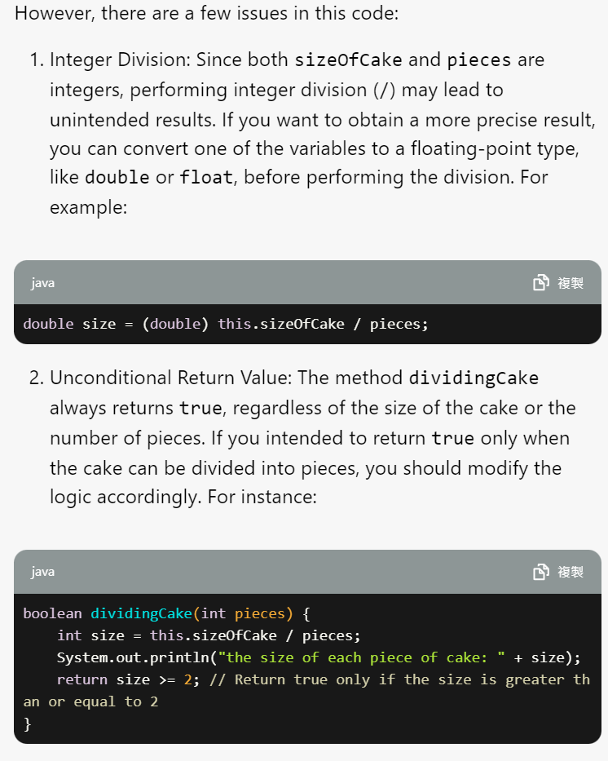
Large Language Model on Lab1

Slide 23
Fuzzing
An automated method to generate test input, execution tests and expose security vulnerability (crashes)

Slide 24
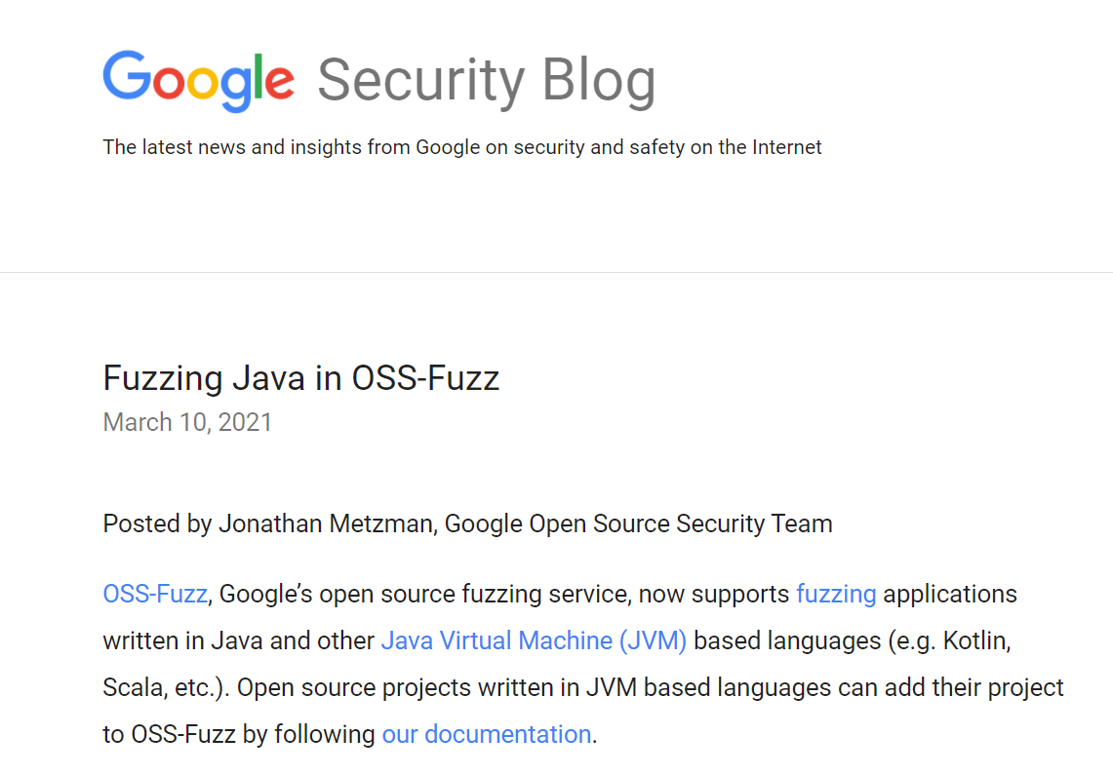
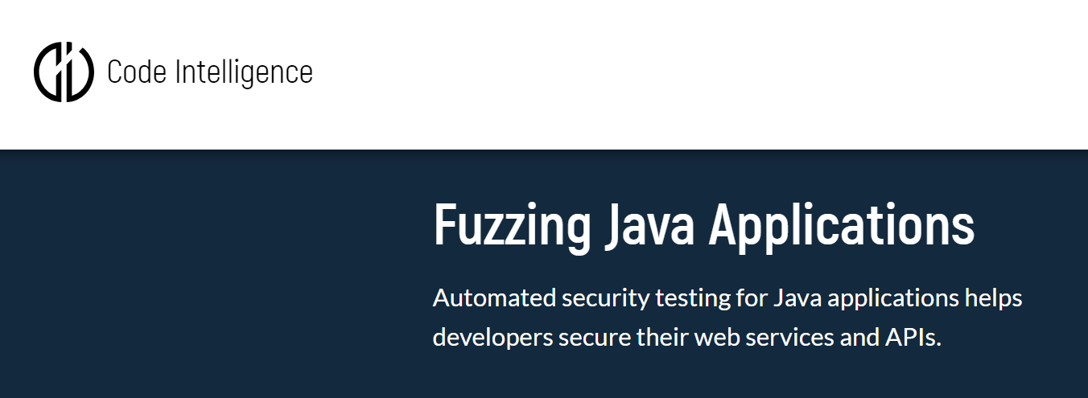

Examples
Find bugs + code coverage

Slide 25
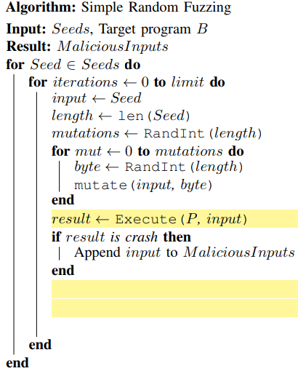
What is Fuzzing?
If you developed Android apps before, you may use monkey [5], which is a fuzzing tool.
Fuzzing is the process of finding vulnerabilities code by repeatedly testing the code with modified inputs [6].
is becoming standard in the commercial software development process [6].
Seed input in text: High, 30
Seed input in byte:
0000101
0010101
The mutate function mutates a byte of the input in the byte position

Slide 26
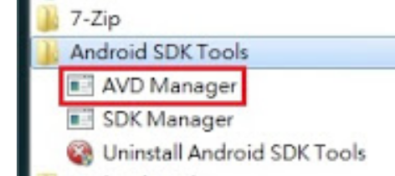
e.g., Android Monkey
https://developer.android.com/studio/test/monkey
Prerequisites : install Java JDK and Android SDK
Select the required Android version in Android SDK Manager
Use the AVD Manager to create an Android Virtual Device
Choose a device template from Device Definitions, then press [Create AVD]
Select the CPU type (e.g., ARM) and Skin (to emulate some of the most common screen configurations), and then launch the AVD
Use Windows cmd window
Go to directory c:\users\<user>\appdata\local\Android\android-sdk\platform-tools
Type ‘adb devices’ to find the AVD name (e.g., emulator-1234)
Start Monkey
adb shell monkey [options] <event-count>
adb shell monkey -p your.package.name -v 500
Notes:
If you have installed choco, then you can use choco to install JDK and Android. Google the exact choco packages
https://chocolatey.org/packages/jdk10
Use Windows PowerShell (admin)
choco install jdk10
choco install android-sdk
How to set up choco?
1. Setting up Chocolatey. In PowerShell (admin), type the following comment:
set-executionpolicy bypass .
2. When prompted, press ‘A’ to accept the elevated privileges.
3. And then, set up Chocolately by typing the following commend:
Set-ExecutionPolicy Bypass iex ((New-Object System.Net.WebClient).DownloadString('https://chocolatey.org/install.ps1'))

Slide 27
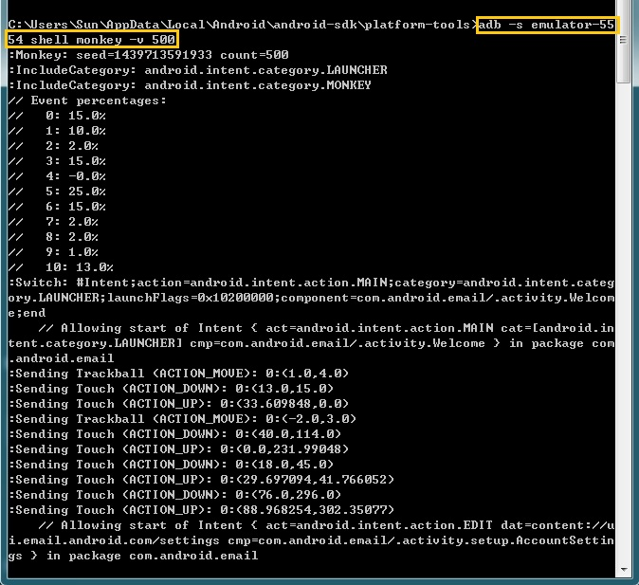
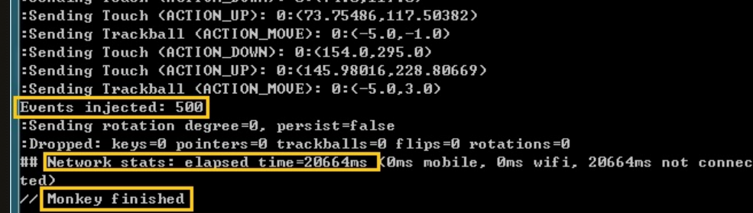
Example (from the Web)
adb -s emulator-5554 shell monkey -v 500
Event probability
Source: http://sunmr.blogspot.com/2015/08/android-monkey-test.html
Notes:
Source: http://sunmr.blogspot.com/2015/08/android-monkey-test.html

Slide 28
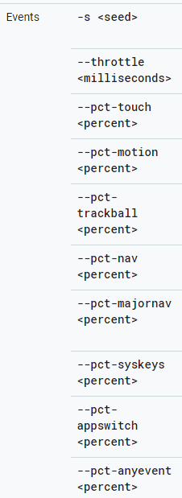
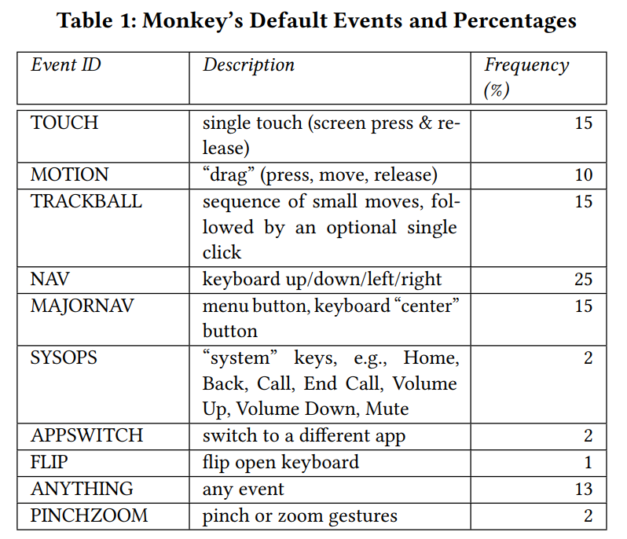
Monkey
Monkey’s command line argument.
Developers can specify the distribution of kind of events to define a test profile.
The Monkey tool emulates user interaction with an app. It generates and injects gestures commands (see the table on the right) or system events based on a predefined event frequency distribution into the app’s event input stream.
The tool watches for exceptional conditions, e.g., the app crashing or throwing an exception.
The tool can vary the “throttle”, i.e., the time delays between events; by default, there is no delay between events (throttle = 0).

Slide 29
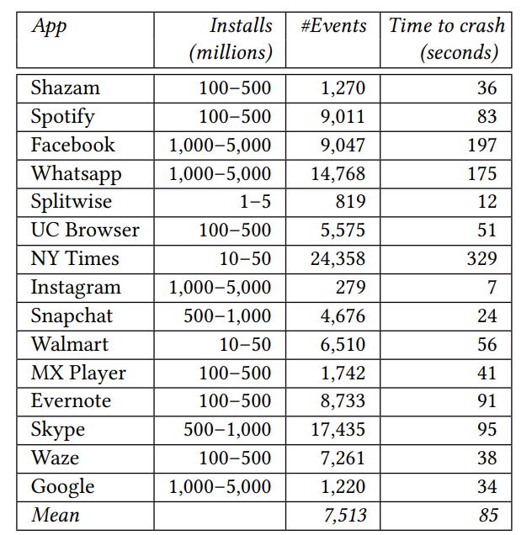
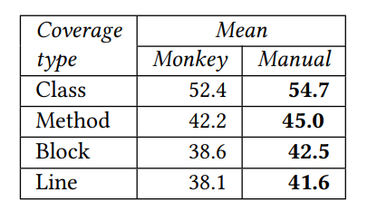
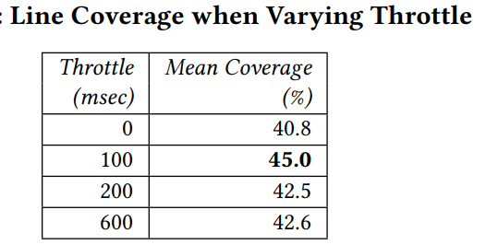
Monkey [Crash (Yes), Code Coverage (No)]
Find crash via stress test? Yes
Manual testing has better code coverage than Monkey
Setting different time delays is insignificant to improve code coverage
(set throttle = 0)

Slide 30
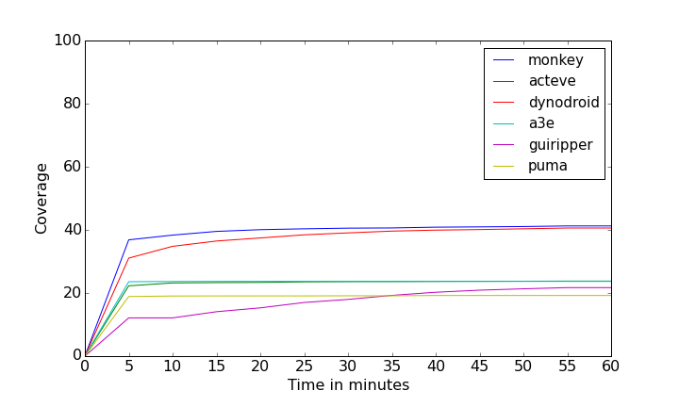
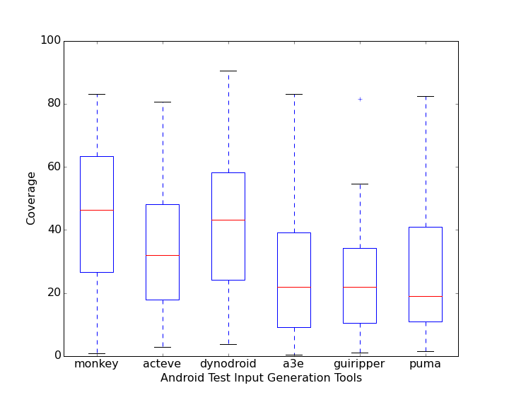
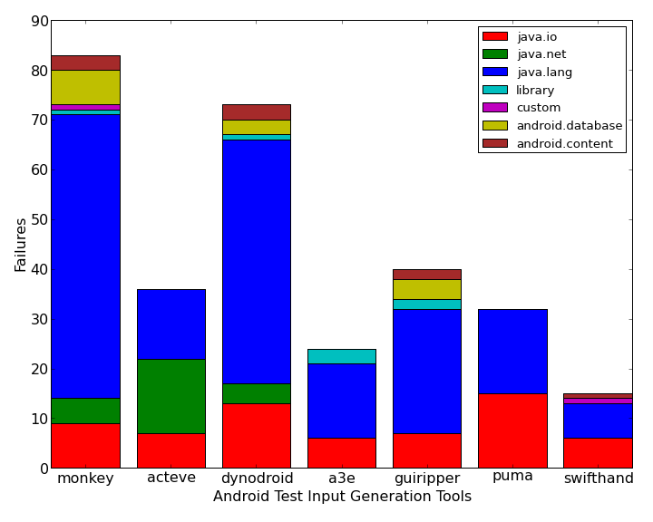
Other Android Fuzzing Tools [11] Lower code coverage and fewer crashes than monkey

Slide 31
Variants of Monkey
Instead of command-line monkey, one can write code to interact with an API version of monkey, and thus produce one’s own (simple) fuzz testing tool.
https://developer.android.com/studio/test/monkeyrunner/
You can build your own fuzzer
The best-known fuzzing tool is American Fuzzy Lop (AFL) [8], a grey-box mutation-based feedback-based fuzzer for gcc/clang c++ code projects. It has been ported to support testing the code written in other programming languages and beyond Lunix.
E.g., for Windows binaries: https://github.com/ivanfratric/winafl
E.g., for Android app: https://github.com/ele7enxxh/android-afl
myMonkey
Test profile generation
Fuzzing
Result Visualization

Slide 32
American Fuzzy Lop (AFL)
Feedback-based: run, get info from previous runs in guiding the selection of the next input
Mutation-based: change inputs to become new inputs
Grey-box: need both input seeds and code coverage
The basic strategy of AFL:
Start with a small set of input sample files as a queue of inputs
The test cases for user stories (in Scrum) can be these seed files
Mutate “randomly” an input file from the queue
If the mutated file reaches new or simpler path(s) (in log2 sense), add it to the queue

Slide 33
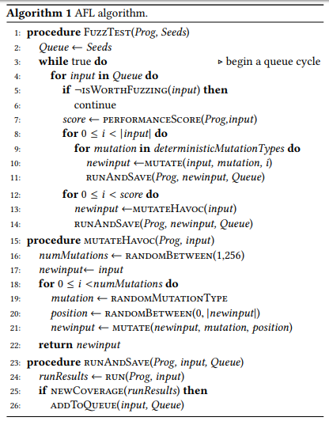
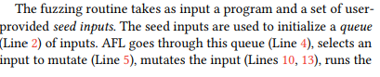
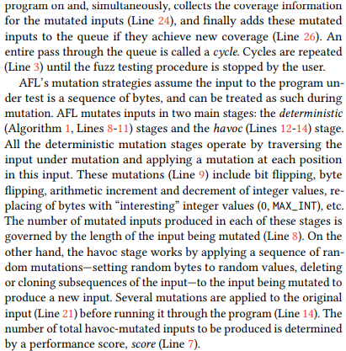
American Fuzzy Lop Algorithm [13]

Slide 34
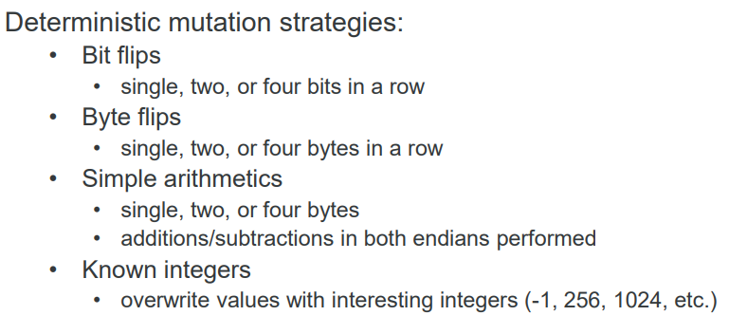
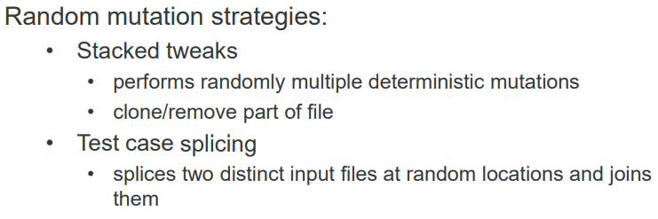
in the AFL Algorithm
Line 4, always select the first element in Queue.
isWorthFuzzer(x): the input x discovered new program branch at line 25 when x was added to Queue (so, always worth fuzzing)
PerformanceScore(P, x): return 1 for AFL
Mutation: a binary string mutation operator
newCoverage(x’s result): e.g., running P(x) and find that x executes a new branch not covered by any test cases before (or executes a branch an order of magnitude (in binary sense) smaller than previous test cases).

Slide 35
Ways to Modify AFL
Why not replacing the set of mutation operators in AFL by a new mutation tool?
Yes. Try radamsa. https://gitlab.com/akihe/radamsa
Yes. Write your own set of mutation operators
PerformanceScore(x) should be fixed when the same input is selected?
Any good idea to make the score returned for the same input x be adaptive?
Can we change AFL to a pure block-box fuzzer or GUI fuzzer?
Yes. How to modify Algorithm of AFL? Any good idea?
Probably, newCoverage(x’s result) is determined from program output, or compare x against those inputs in Queue.
Can we use UIAutomator API in Android to check Widget coverage and integrate with Monkey to generate better inputs?
Any better way to find more unexplored paths? see [13]
A faster version of AFL? See [14]. Google ossfuzzer is built on top of afl.

Slide 36
SideBar
Read Section 4.4 in Ref [3]
What is the consequence of designing an inadequate set of test scenarios?
Read some low-rated reviews/posts of a high-rated app in an app store (Apply Store, Google Store etc). Can you propose ways to find out what are missing?
Try American Fuzzy Lop together with Address Sanitizer (ascan) through the following steps in Tutorial 2 and 3 of Ref [8], and then pick a serious program (e.g., see the program list on http://lcamtuf.coredump.cx/afl/) and start fuzzing it.
The combination of American Fuzzy Lop and Address Sanitizer is a gold standard for program fuzzing.
There are many open-source Sanitizers to detect different kinds of bugs.
AddressSanitizer (ascan) for memory corruption bugs (e.g., buffer overflow)
Thread Sanitizer (tscan) for thread concurrency bugs (e.g., data races)
MemorySanitizer (mscan) for of uninitialized reads bugs
UndefinedBehaviorSanitizer (ubscan), Kernel Address Sanitizer (kascan)
Some of them are available for testing Android apps: https://source.android.com/devices/tech/debug/sanitizers

Slide 37
OK, Crashes Found. So What?
Fuzzing finds crashes or ANR (App Not Responding), so-called code vulnerabilities
In most cases, developers may start debugging based on the failing test cases (e.g., with stack traces)
How do we know we have fixed the problem?
If an input is long (e.g., crash a computer game by fuzzing), the debugging will be tedious and slow.
More desirable to find a smaller input to trigger the same bug before debugging.
How?

Slide 38
Scientific Debugging

Slide 39
Distinguishing Failures from Bugs
A failure is an incorrect output of a program.
E.g., in JUnit, we may use the API call AssertEqual() to determine whether or not the test case fails.
A bug (or fault) is an incorrect implementation (coding) that causes the program to produce failures.
Suppose: Correct: int f_{c}(x) = { return x*x + 3 * x + 2; }
Buggy: int f_{b}(x) = { return x*x + 2 * x + 3; }
f_{b}(0) = 3 ≠ 2 = f_{c}(0). So, the test case x = 0 produces an incorrect output 3 from f_{b}.
Comparing the code of f_{b} and f_{c}, we see that the sentence is written wrongly.
The sentence x*x + 2 * x + 3 contains a bug (fault).

Slide 40
How to Debug?
1. Locate Bug
2. Repair Program
3. Retest Program
We use three steps in a row for this purpose:

Slide 41
A model of program execution
A program P is a set of statements and a set of variables.
Each variable keeps a value.
Each statement may read a value from one or more variables and/or write a value to a variable.
Outputting a value from a program means to write a value to a (system-specific) variable.
A program state is a set of key-value tuples, each containing a variable v as the key and the value of the variable v.
An execution trace is a sequence of executed instructions to represent the execution of a test case.
Note that the same program statement may occur in the same trace multiple times (and so we have 1st occurrence, 2nd occurrence, etc.)
Thus, by walking through the statements in an execution trace σ from start to end and one by one, the program state of the execution trace σ is updated while we walk through the trace.

Slide 42
A model of program execution Failure and Bug
Failure
A failure of a program P is an incorrect program output of an execution trace σ of the program P.
We mark the statements that produce the failure on the trace σ
Run
A failing run refers to an execution trace that is marked with failure(s).
A passed run refers to an execution trace that is not marked with any failure.
Bug
A bug (also known as a fault) is a mistake appearing in a program P.
E.g., In an execution trace σ, a bug is marked as an incorrect single statement or an incorrect non-empty subsequence of statement in it. Thus, the positions of a bug can be marked in the execution trace σ. Note that some execution traces do not contain any bug.

Slide 43
A model of program execution Propagation from Bug to Failure
To observe a failure from a run, a bug should propagate its error along the trace from a buggy statement (say at position σ[b]) to the statement outputting a failure (say at position σ[f]).
The buggy statement σ[b] transforms a correct program state before executing this buggy statement into an infected program state E_{b}.
If there is any difference between the expected program state and an infected program state, the infected program state incurs an error.
From the position of this infected program state E_{b}, the subsequent instructions (at positions σ[b+1], σ[b+2], …., σ[f]) in the trace σ will further transform E_{b} into a sequence of infected program states E_{1,} E_{2,} …., E_{f} . When the statement at the position σ[f] is executed, the corresponding error in the infected program state E_{f} will be observed as a failure of the execution trace σ.

Slide 44
Illustration: Relating Execution Information to Program States
1. int foo (int a, int b)
2. {
3. POINT pA = null; // bug
4. …
5. for () {
6. POINT pB = pA;
7. …
8. if () {
9. pB[3] = 0;
10. …
11. }
12. }
13. }
A pointer assigned to NULL
Another assignment
A problematic memory access

Slide 45
Program State
The values of variables
Program states
1. int foo (int a, int b)
2. {
3. POINT pA = null; // bug
4. …
5. for () {
6. POINT pB = pA;
7. …
8. if () {
9. pB[3] = 0;
10. …
11. }
12. }
13. }

Slide 46
Program State
The values of variables
Program states
→ | Start | pA : N\A | pB : N\A | …
1. int foo (int a, int b)
2. {
3. POINT pA = null; // bug
4. …
5. for () {
6. POINT pB = pA;
7. …
8. if () {
9. pB[3] = 0;
10. …
11. }
12. }
13. }
N\A = undefined

Slide 47
Program States
Infected: It means the value of a variable is not correct.
Program states
→ → | Start | pA : N\A | pB : N\A | …
 | Line 3 | pA : null | pB : N\A | …
1. int foo (int a, int b)
2. {
3. POINT pA = null; // bug
4. …
5. for () {
6. POINT pB = pA;
7. …
8. if () {
9. pB[3] = 0;
10. …
11. }
12. }
13. }
infect

Slide 48
Program States
Program states
→ → → | Start | pA : N\A | pB : N\A | …
 | Line 3 | pA : null | pB : N\A | …
 | Line 6 | pA : null | pB : null | …
1. int foo (int a, int b)
2. {
3. POINT pA = null; // bug
4. …
5. for () {
6. POINT pB = pA;
7. …
8. if () {
9. pB[3] = 0;
10. …
11. }
12. }
13. }
infect
Note that the infected program state
has prorogated along the execution.

Slide 49
Program States
Program states
→ → → | Start | pA : N\A | pB : N\A | …
 | Line 3 | pA : null | pB : N\A | …
 | Line 6 | pA : null | pB : null | …
 | Line 9 | pA : null | pB : null | …
1. int foo (int a, int b)
2. {
3. POINT pA = null; // bug
4. …
5. for () {
6. POINT pB = pA;
7. …
8. if () {
9. pB[3] = 0;
10. …
11. }
12. }
13. }
crash
Null pointer reference!
A program crash is the result.

Slide 50





From Bug to Failure
Our Debugging Objective:: We want to break the chain so that a bug will not cause the program to produce a wrong output.
A programmer creates a bug
When executed, the fault creates an infection [感染] (an error in the program state) (e.g., ✘)
The infection propagates to make the following statements to compute wrongly.
The infection causes a failure ♣ at the program output.
input
✘
e.g., a bug at a statement
✘
✘
program states
✘
♣
time
output

Slide 51
We need Three Steps to Solve the Debugging Problem: “How to Debug?”
1. Locate Bug
2. Repair Program
3. Retest Program
Verify that the identified infection propagation chain have been broken, and all other correct runs still output correctly.
Find the infection propagation chain (or its fragments) mentioned in the previous slides
Break the infection propagation chain so that
no failure can be observed.

Slide 52
The basic idea is to show “Causes and Effects”
The cause of any event (”effect”) is a preceding event without which the effect would not have occurred.
To prove a cause-and-effect relationship, we must show both legs as follows:
the effect DOES occur when the cause DOES occur (e.g., on slide 44, the run crashes when the variable pA at statement 3 keeps a null value.)
the effect DOES not occur when the cause DOES not occur. (e.g., if the run does not crash when the variable pA at statement 3 does not keep a null value, which require us to revise the program to confirm.)

Slide 53
The Procedure of Scientific Method [19]
Observe some aspect of the thing.
Formulate a hypothesis consistent with the observation in step 1.
Use the hypothesis in step (2) to make new predictions.
Tests the predictions by new experiments
Repeat 2 to 4 to refine the hypothesis in step 2.
Notice the order of steps 2 and 3 ahead of step 4. Do not swap them.

Slide 54
Example:
Combining 1 & 2, the hypothesis is wrong. It has no effect on the outcome of the prediction.
the effect DOES occur when the cause DOES occur
Observation: John owns and drives a supercar back to office everyday.
Hypothesis: Every superrich owns a supercar
Prediction: His home is super large.
Experiment: Place a home visit.
Observation from this Experiment: Wow! He lives in a castle
Observation: Johnson does not own any supercar.
Hypothesis: Every superrich owns a supercar
Prediction: He is not a superrich. His home is not super large.
Experiment: Place a home visit.
Observation from this Experiment: Wow! He also lives in a castle!
the effect Should NOT occur when the cause DOES NOT occur

Slide 55

Scientific Method for Debugging
Information
Bug Report
Hypothesis is not rejected:
Code
refine a better hypothesis
for the same step
Hypothesis
Prediction
Experiment
Observation
+ Conclusion
Run
Hypothesis is rejected:
create new hypothesis
as the next step
More Runs
Fault Diagnosis
Not to debug a program followed by reverse-engineering the cause!

Slide 56
Debugging a Buggy “Sort” Program
$
sort 9 8 7
Purpose of the given program sort:
Rearrange the list of integers from the smallest to the largest
Output: 7 8 9
$
sort 11 14
Output: 0 11
So, let’s use the scientific method to debug this program.

Slide 57
Initial Hypothesis
Hypothesis
Prediction
Experiment
Observation
Conclusion
“sort 11 14” computes correctly.
Output is “11 14”
Run “sort 11 14”
Output is “0 11”
Hypothesis is rejected.
There is a bug in the program!

Slide 58
int main(int argc, char *argv[])
{
int *a;
int i;
a = (int *)malloc((argc - 1) * sizeof(int));
for (i = 0; i < argc - 1; i++)
a[i] = atoi(argv[i + 1]);
shell_sort(a, argc);
printf("Output: ");
for (i = 0; i < argc - 1; i++)
printf("%d ", a[i]);
printf("\n");
free(a);
return 0;
}
We wonder: Does a[0] = 0 hold at this statement (Line 37)? To know it, we testify whether its negation form is true.
Line 6
Line 37
From the Initial Hypothesis, we can find out that the value “0” at the output is due to the value at “a[0]”.

Slide 59
Hypothesis 1: a[]
Note: the run = “sort 11 14”
Hypothesis
Prediction
Experiment
Observation
Conclusion
The run does not cause a[0] = 0
At Line 37, a[0] should not be 0.
Observe the value of a[0] at Line 37.
a[0] = 0 , contradict to the prediction
Hypothesis is rejected.
We now know that a[0] is a part of the infected state

Slide 60
int main(int argc, char *argv[])
{
int *a;
int i;
a = (int *)malloc((argc - 1) * sizeof(int));
for (i = 0; i < argc - 1; i++)
a[i] = atoi(argv[i + 1]);
shell_sort(a, argc);
printf("Output: ");
for (i = 0; i < argc - 1; i++)
printf("%d ", a[i]);
printf("\n");
free(a);
return 0;
}
We wonder: Is the program state of a[ ] correct at line 6
(i.e., right before invoking
sell_sort()?
Line 6
Line 37
We have known that “a[0]” at line 37 is infected through rejecting Hypothesis 1.

Slide 61
Hypothesis 2: shell_sort()
Hypothesis
Prediction
Experiment
Observation
Conclusion
The infection does not take place until the procedure shell_sort is about to execute.
At Line 6, a[] = [11, 14]; argc= 2
Observe a[] and argc at Line 6.
a[] = [11, 14, 0]; argc = 3.
Hypothesis is rejected.
We now know that both a[] and argc have been infected.

Slide 62
int main(int argc, char *argv[])
{
int *a;
int i;
a = (int *)malloc((argc - 1) * sizeof(int));
for (i = 0; i < argc - 1; i++)
a[i] = atoi(argv[i + 1]);
shell_sort(a, argc);
printf("Output: ");
for (i = 0; i < argc - 1; i++)
printf("%d ", a[i]);
printf("\n");
free(a);
return 0;
}
argc is from the input and has not ever been modified before line 6.
We now know that both a[] and argc have been infected.
By Hypothesis 2
Line 6
Line 37
We have known that “a[0]” at line 37 is an inflected state by Hypothesis 1.

Slide 63
Hypothesis 3: argc
Hypothesis
Prediction
Experiment
Observation
Conclusion
Invocation of shell_sort() with size = argc causes the failure.
Changing argc to argc - 1 at line 6 in code should make the run successful.
Change argc to argc - 1 at line 6 in code, recompile, and re-run the program with the test case
The output is now correct.
Hypothesis is confirmed.

Slide 64
Fixing the Program and Re-Test
int main(int argc, char *argv[])
{
int *a;
int i;
a = (int *)malloc((argc - 1) * sizeof(int));
for (i = 0; i < argc - 1; i++)
a[i] = atoi(argv[i + 1]);
...
}
Run the previously failed test cases.
Run the previously passed test cases as well!
$
sort 9 8 7
Output: 7 8 9
shell_sort(a, argc);
shell_sort(a, argc - 1);
$
sort 11 14
Output: 11 14
Note: In C/C++, argc counts the total number of arguments plus 1 (for the program name “sort”).

Slide 65
Fault Diagnosis
Cause is “Invoking shell_sort() with argc”
Validated by a pair of experiments:
Invoked with argc, the failure occurs;
Invoked with argc - 1, it does not.
Side-effect of scientific debugging: we have a fix

Slide 66
Reminder
The scientific method is tedious to apply, but it always works.
So, if we have exhausted our own ideas to debug our programs but still failed, try it.
A key merit of the scientific method is that we not only locate the bug, but also produce a code fix (i.e., a patch of the code to correct the program!)

Slide 67
Delta Debugging [17]
Input Reduction or Code Reduction

Slide 68
Motivation of Delta Debugging
Use case 1:
A web browser crashed when printing a webpage. If the webpage is large, it is a good idea to make the webpage smaller and at the same time able to crash the web browser before examining the details.
Use case 2:
Tools like Appium [16] or Selenium can help to apply the same sequence of UI events to mobile apps or native apps
They are effective tools
Question: How to integrate with the fuzzing tool like AFL? (as Seeds)
If the input data sequence is long, it would be better if we could shorten the input data sequence but reproduce these crashes

Slide 69
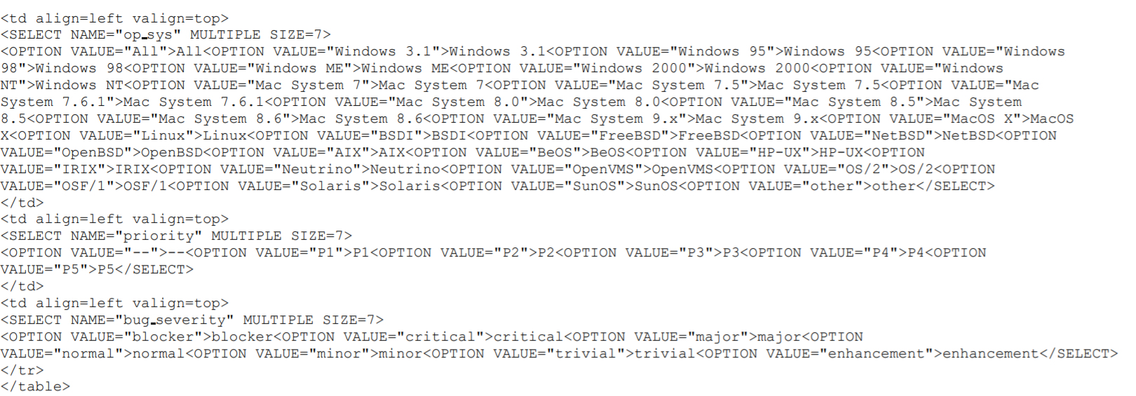
Example 1: Printing this HTML page crash Mozilla web browser
The crash is due to this statement
This HTML page has 40k+ characters
Still produces the same crash after deleting line segments H1 and H2

Slide 70
Input File Reduction
In the process, ensure we can still crash the web browser by printing the page.
Remove single character one at a time: 40k tests
Too fine-grained. Look at too many test cases --- tried.
More sensible strategy:
First: cut away large parts
Then: iteratively cut out the other parts bit by bit.

Slide 71
Illustration
This part still crash the program
Cut the web page here and there
The failure causing input
Set up the 1st hypothesis
Test the 1st hypothesis
more iterations
Input with smaller size
Set up the 2nd hypothesis
Test the 2nd hypothesis

Slide 72
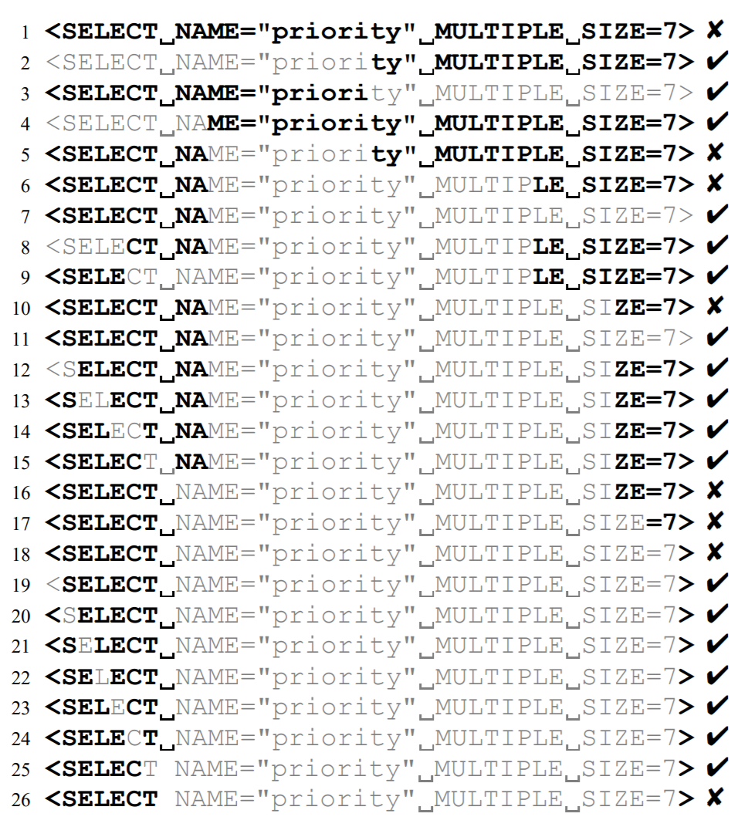
Reduction
Strategy: Try by reducing firstly by half (and if not work) then randomly
Try 1, crash.
Try a part of 1 (e.g., 2, 3, 4), no crash, continue, … find 5
Try a part of 5 (e.g., 6). Lucky, crash found when 6.
Try a part of 6 (e.g., 7, 8, 9, 10). Crash found when 10.
Try a part of 10 (e.g., 11 to 16). Crash found when 16.
Try a part of 16 (e.g., 17), crash found when 17.
Try a part of 17, crash found when 18.
Try a part of 18 (e.g., 19-26), crash found when 26.
Try a part of 26, no more crash can be found.
So, the case 26 is the reduced input.

Slide 73
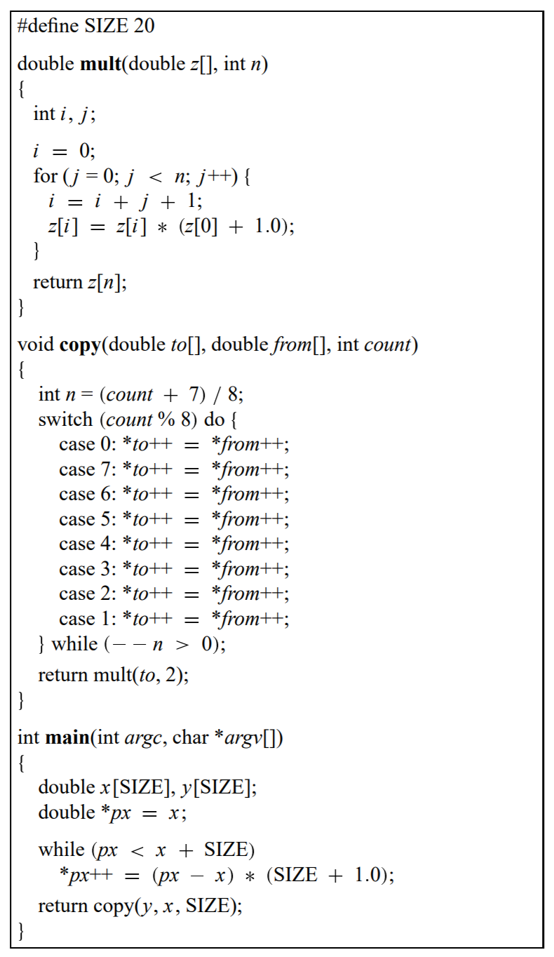
Example 2: bug.c to crash gcc V2.95.2 (Intel/Linux)
Which part of this program crashes the gcc compiler?
=> Remove half of the program, try compiling the program again, and follow the strategy on the last slide.
=> Remove program segments while making the program syntactically correct
double mult(double z[],int n)
{ int i,j;
for(;;){
i=i+j+1;
z[i]=z[i]*(z[0]+1.0);
}
return z[n];
}

Slide 74
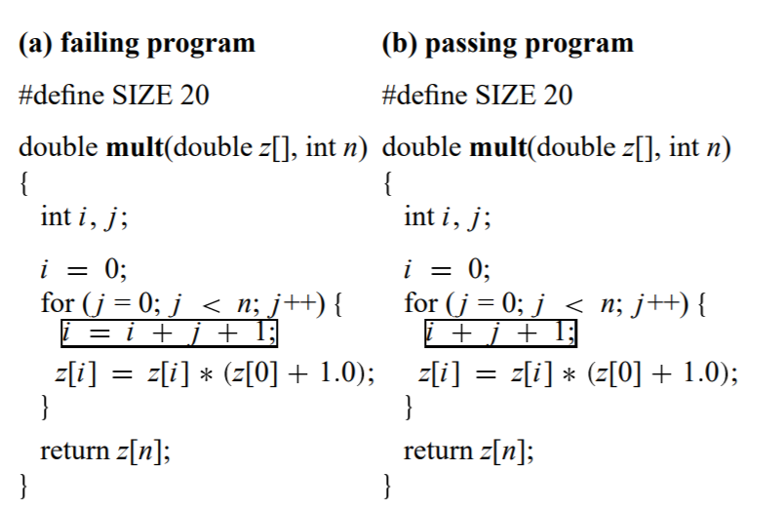
Example 2: bug.c to crash gcc V2.95.2 (Intel/Linux)
Crash the gcc compiler
Does not crash the gcc compiler
Actual bug in the gcc compiler:
inlining the expression i + j + 1 in the array accesses z[i] on the following line.

Slide 75
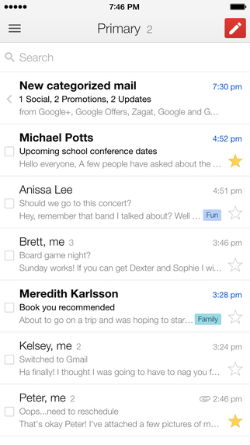
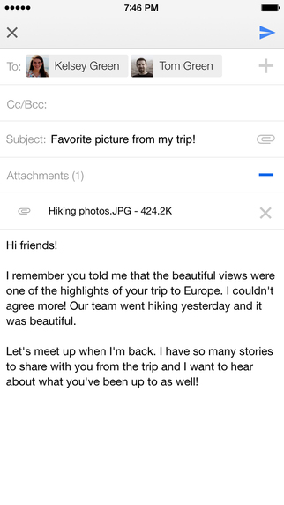
Example 3: Shorten Input Data Sequences for Android App?
Testing android app generating a long sequence of events
Reduce the input event sequence by taking the hierarchical interaction session into account
E.g., purge out 2-5 while keeping <0, 1, 6> and crash the app
0
1
6
2
3
4
5

Slide 76
Example 3: Shorten Input Data Sequences for Android App?
Can reduce the input data sequence to a few events to trigger the same crash and not too slow (spending a few seconds to 1000 seconds in experiment)

Slide 77
AI for delta debugging?
Delta debugging requires a search process to explore different input segments.
Rather than a random search within a target set of regions within the original input, AI can help to identify the insights to guide how to split the current inputs for the next round of exploration.

Slide 78
Delta Debugging [17] in Nutshell https://dzone.com/articles/debugging-step-step-delta
Double-click to open this Word document to see a buggy Quicksort program written in Java.
Run it online, say at: https://www.jdoodle.com/online-java-compiler/
Input: 4, 12, 9, 14, 3, 10, 17, 11, 8, 7, 4, 1, 6, 19, 5, 21, 2, 3
Output: 1, 3, 2, 5, 3, 4, 4, 6, 7, 8, 9, 10, 11, 12, 14, 17, 19, 21
The output numbers are not in a sorted order. Failure observed.
So, the input triggers a failure. We call it as a failure-inducing input. Try Delta Debugging for 30 mins to find a smaller failure-inducing input (see the next slide for process)
Delta debugging [17] is to remove some parts of a failure-inducing input to see the reduced input produces the same failure. If yes, treat the reduced input as a failure-inducing input and continue the incremental removal, otherwise, start again from a failure-inducing input.
this image is a Word document
Notes:
import java.io.*;
import java.util.*;
public class QuickSort
{
public static void quicksort(int numbers[], int low, int high) {
int i = low, j = high;
// Get the pivot element from the middle of the list
int pivot = numbers[low + (high-low)/2];
// Divide into two lists
while (i <= j) {
while (numbers[i] < pivot) {
i++;
}
while (numbers[j] > pivot) {
j--;
}
if (i <= j) {
exchange(numbers, i, j);
}
i++;
j--;
}
// Recursion
if (low < j)
quicksort(numbers, low, j); //low
if (i < high)
quicksort(numbers, i, high);
}
private static void exchange(int numbers[], int i, int j) {
int temp = numbers[i];
numbers[i] = numbers[j];
numbers[j] = temp;
int k = 1;
}
public static void main(String argv[])
{
int A[] = {4, 12, 9, 14, 3, 10, 17, 11, 8, 7, 4, 1, 6, 19, 5, 21, 2, 3}; // incorrect
// int A[] = {4, 12, 9, 14, 3, 10, 17, 11, 8}; // incorrect
// int A[] = {4, 12, 9, 14}; // correct
// int A[] = {3, 10, 17, 11, 8}; // correct
// int A[] = {4, 12, 9, 14, 3, 10, 17}; // incorrect
// int A[] = {3, 5, 2, 3}; // after many rounds
// minimized failure-induced input
//
quicksort(A, 0, A.length - 1);
for (int i=0 ; i < A.length ; i++) System.out.print(A[i] + " ");
System.out.println();
}
}

Slide 79
In-Class Exercise on Delta Debugging https://dzone.com/articles/debugging-step-step-delta
Hint: It only needs 3-4 numbers in the input to trigger the bug!
Cut the failure-inducing input by half: 4, 12, 9, 14, 3, 10, 17, 11, 8, and get output: 3, 12, 4, 8, 9, 10, 11, 14, 17, i.e., wrong!
Since 4, 12, 9, 14, 3, 10, 17, 11, 8 can produce an error, cut it into half again, say using 4, 12, 9, 14, which the output is correct: 4, 9, 12, 14.
Our guess in Step 2 is wrong, so we try the other half as input, which is 3, 10, 17, 11, 8, obtaining the output: 3, 8, 10, 11, 17, but the program outputs correctly.
Our next input is to reduce our last failure-inducing input by cutting it into two parts randomly, e.g., cutting the last two numbers. The input is 4, 12, 9, 14, 3, 10, 17. The output is erroneous: 4, 10, 9, 12, 3, 14, 17.
We repeat the above process to find a smaller and smaller failure-inducing input to produce the same failure condition (i.e., not in a sorted order).
After many rounds, we will get 4, 3, 5, 2, 3 as a failure-inducing input.
If you choose a different random split, you may get a smaller input to reproduce the failure
Keep your results for your revision in a later time

Slide 80
Progress Illustration for the Exercise [the cutting atop slide 78]
[4, 12, 9, 14, 3, 10, 17, 11, 8, 7, 4, 1, 6, 19, 5, 21, 2, 3]
Output: [1, 3, 2, 5, 3, 4, 4, 6, 7, 8, 9, 10, 11, 12, 14, 17, 19, 21]. ✗
Divide, and try the first half
try the second half
[4, 12, 9, 14, 3, 10, 17, 11, 8]
try the second half
Output: [3 12 4 8 9 10 11 14 17]. ✗
Divide, and try the first half
❶
[3, 10, 17, 11, 8]
[4, 12, 9, 14]
Output: [3 8 10 11 17]. ✓ correct. We guess wrong
Output: [4 9 12 14]. ✓ correct. We guess wrong
What level of failure you seen?
The output is unsorted?
Any one of “3, 2” and “5, 3”?
[7, 4, 1, 6, 19, 5, 21, 2, 3]
❶
Output: [1 2 4 5 3 6 7 19 21]. ✗
❷
Divide, and try the first half
❷
many rounds
Can’t reduce further. So, this is the result
[*, *, *, *]
Notes:
int A[] = { 4, 5, 2, 3};

Slide 81
References and Resources
Bo Jiang, Ye Liu, and W. K. Chan. 2018. ContractFuzzer: fuzzing smart contracts for vulnerability detection. In Proceedings of the 33rd ACM/IEEE International Conference on Automated Software Engineering (ASE 2018). ACM, New York, NY, USA, 259-269. DOI: https://doi.org/10.1145/3238147.3238177
Anca Deak, Tor Stålhane, and Guttorm Sindre. 2016. Challenges and strategies for motivating software testing personnel. Inf. Softw. Technol. 73, C (May 2016), 1-15. DOI=http://dx.doi.org/10.1016/j.infsof.2016.01.002
David Martin, John Rooksby, Mark Rouncefield, and Ian Sommerville. 2007. 'Good' Organisational Reasons for 'Bad' Software Testing: An Ethnographic Study of Testing in a Small Software Company. In Proceedings of the 29th international conference on Software Engineering (ICSE '07). IEEE Computer Society, Washington, DC, USA, 602-611. DOI=http://dx.doi.org/10.1109/ICSE.2007.1
Omission fault: http://www.exampler.com/testing-com/writings/omissions.html
Android monkey: https://developer.android.com/studio/test/monkey
Konstantin Böttinger, Patrice Godefroid, Rishabh Singh: Deep Reinforcement Fuzzing. IEEE Symposium on Security and Privacy Workshops 2018: 116-122. https://arxiv.org/pdf/1801.04589.pdf
Priyam Patel, Gokul Srinivasan, Sydur Rahaman, and Iulian Neamtiu. 2018. On the effectiveness of random testing for Android: or how i learned to stop worrying and love the monkey. In Proceedings of the 13th International Workshop on Automation of Software Test (AST '18). ACM, New York, NY, USA, 34-37. DOI: https://doi.org/10.1145/3194733.3194742

Slide 82
References and Resources
American fuzzy lop (AFL)
Wikipedia page: https://en.wikipedia.org/wiki/American_fuzzy_lop_(fuzzer)
Tutorial to run AFL: https://fuzzing-project.org/tutorial3.html
Official website and source code of AFL: http://lcamtuf.coredump.cx/afl/
Additional tutorials on AFL: https://github.com/ThalesIgnite/afl-training
Needs 3-4 hours to complete
Tobias Ospelt. AFL --- American fuzzy lop: a short introduction: http://floyd.ch/download/introduction-fuzzing-with-afl.pdf
Include the commands and the usage of these commands
Shauvik Roy Choudhary, Alessandra Gorla, and Alessandro Orso. 2015. Automated Test Input Generation for Android: Are We There Yet? (E). In Proceedings of the 2015 30th IEEE/ACM International Conference on Automated Software Engineering (ASE) (ASE '15). IEEE Computer Society, Washington, DC, USA, 429-440. DOI: https://doi.org/10.1109/ASE.2015.89
The code is here: http://bear.cc.gatech.edu/~shauvik/androtest/

Slide 83
References and Resources
Faster Fuzzing: Reinitialization with Deep Neural Models https://arxiv.org/pdf/1711.02807.pdf
Using deep learning to generate seeds to guide AFL to explore program paths
Caroline Lemieux and Koushik Sen. FairFuzz: Targeting Rare Branches to Rapidly Increase Greybox Fuzz Testing Coverage. In Proceedings of ASE’18.
http://www.carolemieux.com/fairfuzz-ase18.pdf
Source code: https://github.com/carolemieux/afl-rb
Marcel Böhme, Van-Thuan Pham, and Abhik Roychoudhury. 2016. Coverage-based Greybox Fuzzing as Markov Chain. In Proceedings of the 2016 ACM SIGSAC Conference on Computer and Communications Security (CCS '16). ACM, New York, NY, USA, 1032-1043. DOI: https://doi.org/10.1145/2976749.2978428
Source code: https://github.com/mboehme/aflfast
Bo Jiang, Yuxuan Wu, Teng Li, and W. K. Chan. 2017. SimplyDroid: efficient event sequence simplification for Android application. In Proceedings of the 32nd IEEE/ACM International Conference on Automated Software Engineering (ASE 2017), 297-307.
Source code: https://github.com/gongbell/SimplyDroid
Appium
introduction: https://hackernoon.com/an-introduction-to-appium-the-best-open-source-mobile-app-automation-tool-940f5eaabae9
Source code http://appium.io/
Tutorials: http://www.automationtestinghub.com/appium-tutorial/

Slide 84
References and Resources
Andreas Zeller and Ralf Hildebrandt. 2002. Simplifying and Isolating Failure-Inducing Input. IEEE Trans. Softw. Eng. 28, 2 (February 2002), 183-200. DOI=http://dx.doi.org/10.1109/32.988498
This is the delta debugging paper
Tony Savor, Mitchell Douglas, Michael Gentili, Laurie Williams, Kent Beck, and Michael Stumm. Continuous Deployment at Facebook and OANDA. In Proceedings of ICSE 2016 companion, pages 21-30, 2016. http://dx.doi.org/10.1145/2889160.2889223
Andreas Zeller. Why Programs Fail: A Guide to Systematic Debugging, 2nd edition. ISBN-13: 978-0123745156. Morgan Kaufmann
Patrice Godefroid.. Fuzzing: Hack, Art, and Science. Communications of the ACM, February 2020, Vol. 63 No. 2, Pages 70-76 https://cacm.acm.org/magazines/2020/2/242350-fuzzing/fulltext#R8
Sanoop Mallissery and Yu-Sung Wu. 2023. Demystify the Fuzzing Methods: A Comprehensive Survey. ACM Comput. Surv. 56, 3, Article 71 (March 2024), 38 pages.

Slide 85
Appendix

Slide 86
Cheat Sheet for Running Java Project in Eclipse https://www.eclipse.org/

Slide 87
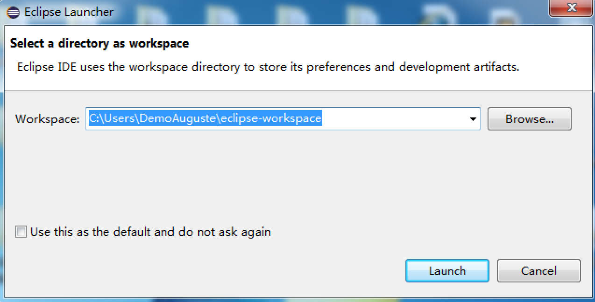
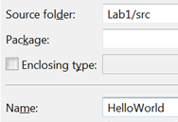
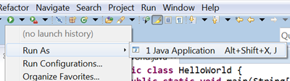
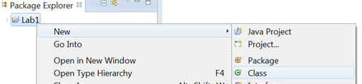
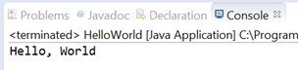
Cheat Sheet for Running Java Project in Eclipse Write, Compile, Execute
Start Eclipse from the CSLab Menu (or install yourself)
Select a directory at your H: drive as the workspace
Select File->New->Java Project
Type “Lab1” as the Project Name and then press “Finish”.
Right click the “Lab1” project. Select New->Class
Type HelloWorld in the Name field (note the Title Case and no space in between), and then press [Finish]
Copy the code in the next slide into the HelloWorld.java panel
Press the [Run] button on the toolbar
Check the output in the Console panel

Slide 88
Cheat Sheet for Running Java Project in Eclipse Hello World
Note: filename must match the name of the class.
/*******************************************
* Prints "Hello, World"
* Everyone's first Java program.
*******************************************/
public class HelloWorld {
public static void main(String[] args) {
System.out.println("Hello, World");
}
}
HelloWorld.java
It is a common practice to use the first comment to describe the purpose of the Java class.
Notes:
Note name of file must match name of class.

Slide 89
Cheat Sheet for Running Java Project in Eclipse Quadratic Equation
Note: filename must match the name of the class.
Quadratic.java
public class Quadratic {
public static void main(String[] args) {
// parse coefficients from command-line
double b = Double.parseDouble(args[0]);
double c = Double.parseDouble(args[1]);
double root1 = 0; // the variable to keep the first root
double root2 = 0; // the variable to keep the second root
// calculate roots
double discriminant = b*b - 4.0*c;
double d = Math.sqrt(discriminant);
root1 = (-b + d) / 2.0;
root2 = (-b - d) / 2.0;
// print them out
System.out.println(root1);
System.out.println(root2);
}
}
Notes:
Note name of file must match name of class.

Slide 90
Cheat Sheet for Running Java Project in Eclipse JUnit (a popular mean to run test cases)
Procedure
Right click the project Lab1. New a package entitled Samples under our project Lab1
Move the two classes written into this Sample package.
View from the Windows Explore to see what the contents of the Lab1\src are?
Right click the project Lab1. Select new->JUnit Test Case
Name the package of the new test case as testcases
Name your test case as TestXXX, where XXX can be any string, but it must be started with Test .
E.g., Test001
Place the code from the next slide into this test case Test001.
Each test method started with the annotation “@Test@” if you use Junit version 4.0 or earlier
Select from the menu Run->Run As->JUnit Test Case

Slide 91
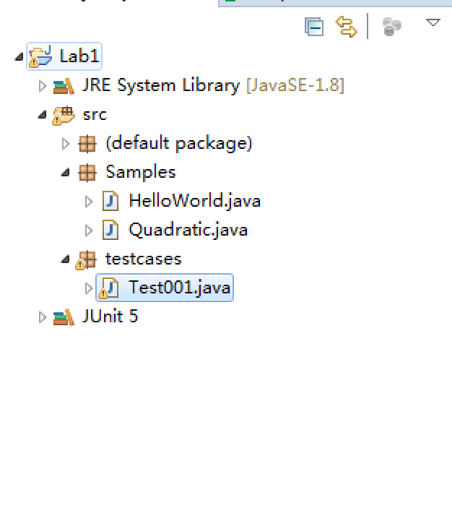
Cheat Sheet for Running Java Project in Eclipse The Test001 test case
We only make use of the automation power of JUnit to ease us to pass input values to our programs developed so far. We have not used the real power of JUnit to help test our programs.
JUnit5
package testcases;
import static org.junit.jupiter.api.Assertions.*;
import org.junit.jupiter.api.Test;
import Samples.*;
public class Test001 {
@Test
public void testHelloWord() {
String[] s1 = null;
HelloWorld.main(s1);
}
@Test
public void testQuadratic() {
String[] s1 = { "-3", "2"} ;
Quadratic.main(s1);
}
}
// for Junit4, replace by these two lines
import static org.junit.Assert.*;
import org.junit.Test;
For Junit 4, see https://junit.org/junit4/faq.html
For Junit 5, see
https://junit.org/junit5/docs/current/user-guide/
check to see using JUnit5 or Junit4

